Slide 1
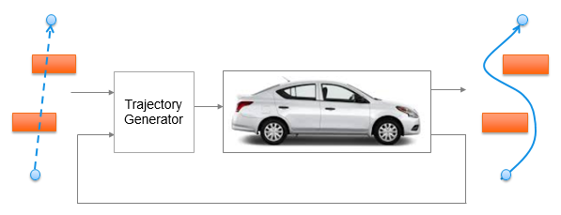
Trajectory Generation in High Density Environment
Final Review
Suvo Ganguli
Alberto Speranzon
July, 2018

Slide 2
Agenda
Project Overview – 1 min
Summary of Accomplishments – 15 min
Future Work – 1 min
Q&A – 3 min
Honeywell Internal
Honeywell Internal
Notes:
Honeywell Internal
2

Slide 3
Project Overview
Project Summary
PI: Suvo Ganguli, Alberto Speranzon
RTC: CNS
Project Name: Trajectory Generation in High Density Environment
Budget: 75K
Problem Statement/Objective:
Trajectory generation in cluttered environment is a key problem to solve for autonomous operations
The goal of this project is to understand the trade-offs between the different parameters used to design trajectory generation in presence of obstacles
Deliverables
Mid Term
Developed 2D trajectory generation algorithm
Design trade-off studies
End Term
Algorithm for avoiding pop-up obstacles
Alternate 2D trajectory generation software without using costly / time-consuming global planner
Comparative and robustness studies
Project Status
YTD Spend: 75K
WORK Complete: 100%
Honeywell Internal
Notes:
Honeywell Internal
3

Slide 4
Basic Concepts
Global Planner
Local Planner
Local Planner – generates trajectory for a finite path
MPC (Model Predictive Control)
Global Planner – generates trajectory from start to end point
Laplacian
MPC
MPC generates a trajectory
By solving an optimization problem for multiple time steps in future
Taking a single time step, and repeating optimization
Takes into account vehicle dynamics
Laplacian generates a trajectory
Assigning high potential to start point, obstacles and low potential to end point
Finding optimal path along the steepest gradient
Does not take into account vehicle dynamics
o
o
o
o
o
MPC
o
o
o
-
Laplacian
+
+

Slide 5
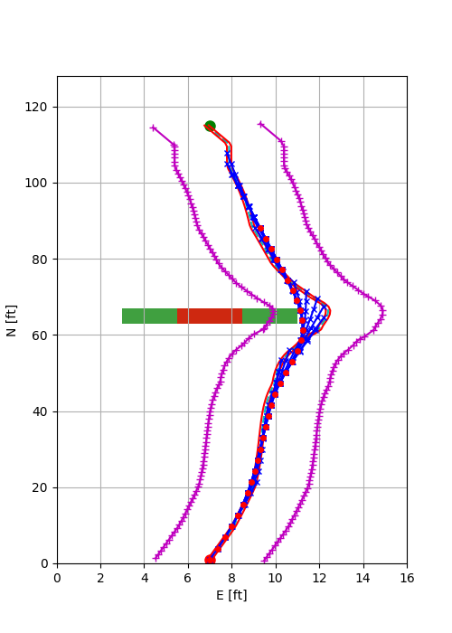
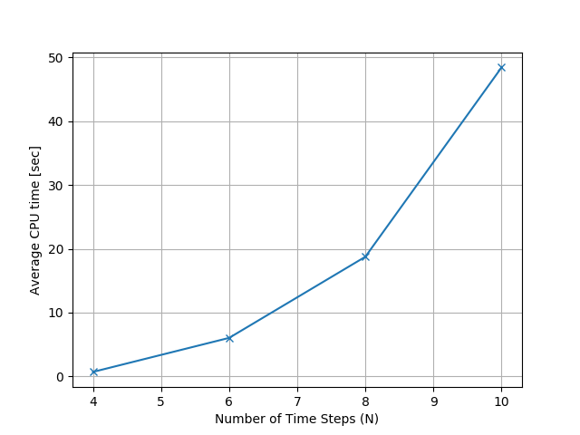
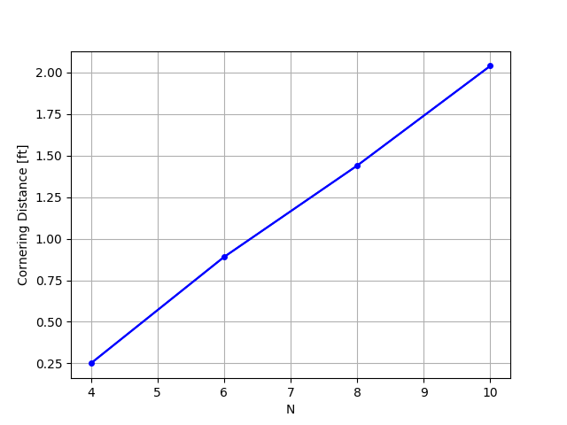
Mid Term Accomplishments
Trajectory Generation Algorithm:
Local Planner – MPC
Global Planner – Laplacian
Obstacles known a priori
Design Tradeoffs (key result):
CPU time vs No. of Time Steps
Trajectory smoothness vs No. of time steps
Laplacian path
Computation time
Trajectory Smoothness
MPC path
Obstacle with safety margin
No. of Time Steps (N)
No. of Time Steps (N)

Slide 6
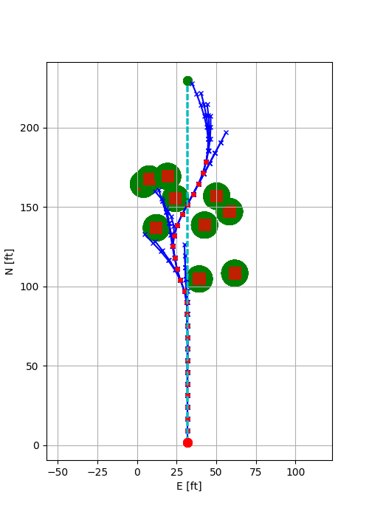
End Term Accomplishments
Trajectory Generation Algorithm
Obstacles not known a priori
Global Planner (only) – MPC
Advantage
Avoid costly re-computation of Laplacian planner (2X-3X reduction)
Robustness Study
100 test cases with 10 obstacles (pop-up)
99 out of 100 test cases successfully generated trajectory
Specific test cases to analyze occasional failure
MPC Horizon
MPC Path
Obstacles with Safety Margin
Field of View
Honeywell Internal
Notes:
Honeywell Internal
6

Slide 7
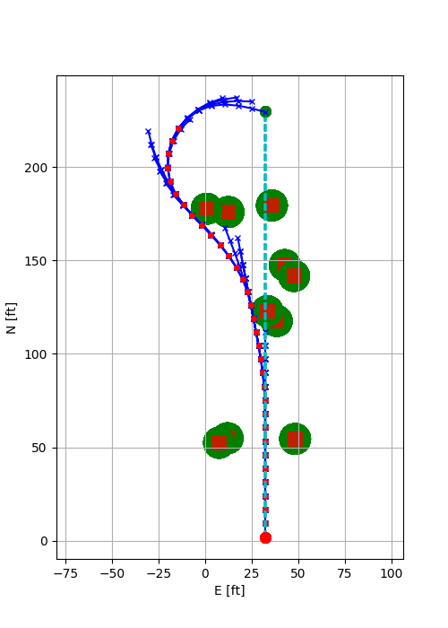
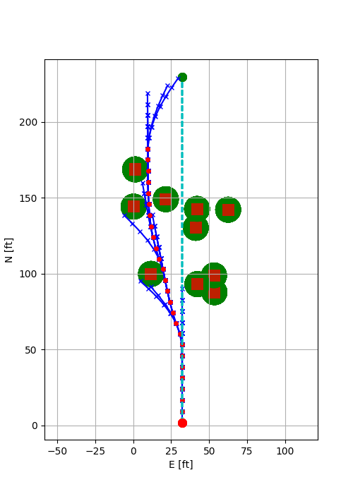
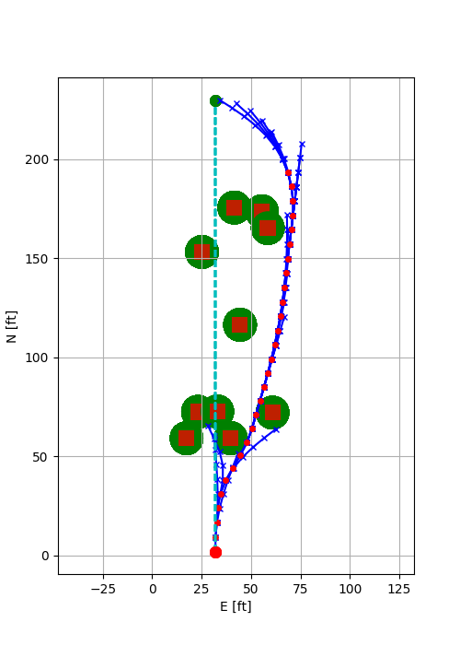
MPC Randomized Test Cases
MPC Trajectory Generator relative heading constraint is changed from 90 deg to 30 deg when no obstacles are in view
MPC Trajectory Generator changes the heading of the path upon finding less “costly” path
Honeywell Internal
Notes:
Honeywell Internal
7

Slide 8
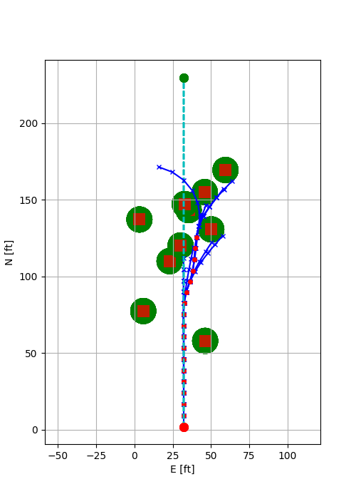
MPC Trajectory Generator is trapped and unable to progress farther.
It turns right to follow the less “costly” path until it views another obstacle for which no feasible path can be generated.
MPC Randomized Test Cases
MPC Trajectory Generator changes the heading of the path upon a “dead end”
causes infeasibility
Would have lead to longer trajectory
Honeywell Internal
Notes:
Honeywell Internal
8

Slide 9
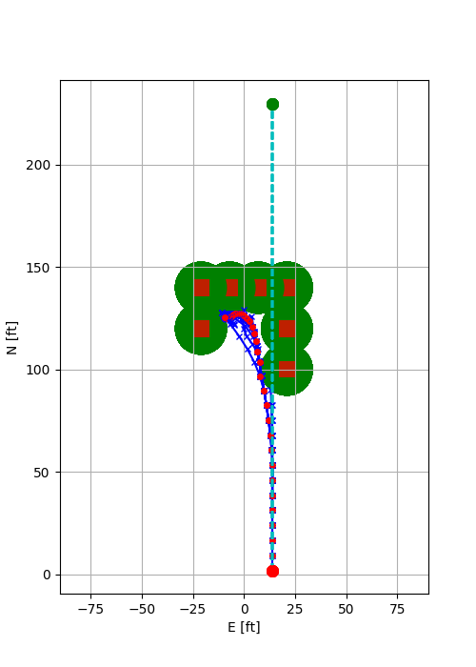
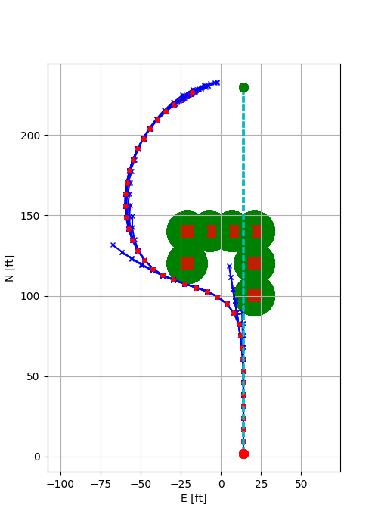
MPC Specific Test Cases
MPC Trajectory Generator is trapped and slows down to zero speed due to tighter turn constraint
MPC Trajectory Generator successfully reaches the end point with relaxed turn constraints
Tighter turn constraint
Relaxed turn constraint
Honeywell Internal
Notes:
Honeywell Internal
9

Slide 10
Future Work
Modify algorithm to maintain a family of feasible paths:
Modify problem formulation to allow velocity reversal
Continue on the MPC path computed in the previous time step and run a less costly global planner (e.g., Probabilistic Road Maps) to re-initialize the MPC problem
Optimize algorithm to run in real time.
Use near-optimal values to reduce the number of iterations
Use efficient linear solvers which is used by the nonlinear optimizer
Honeywell Internal
Notes:
Honeywell Internal
10

Slide 11
Q&A
Honeywell Internal
Notes:
Honeywell Internal
11

